Slide 1
Micro-Teaching Demo
EDUC 490 – TEACHING PRACTICUM
Dr. David Litz

Slide 2

Getting Ready for Reading After Lunch
A Step-by-Step Procedure
for a Smooth Transition

Slide 3
Lesson Objective
Understand and follow the steps to transition smoothly from lunch to independent reading.
Use the two bell signals to guide the process.
Make sure everyone knows how to get their books out and start reading quickly, so we can use our time wisely and enjoy our reading.

Slide 4
Why Have a Routine?
After lunch, it’s important to shift our focus from free time to learning.
Following a clear routine helps us use our reading time wisely and stay organized
Why do you think having a routine is important in our classroom?

Slide 5
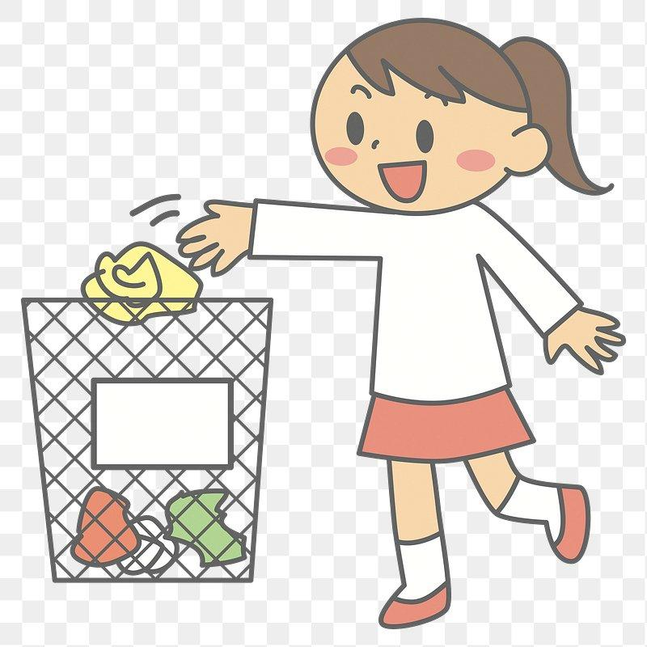
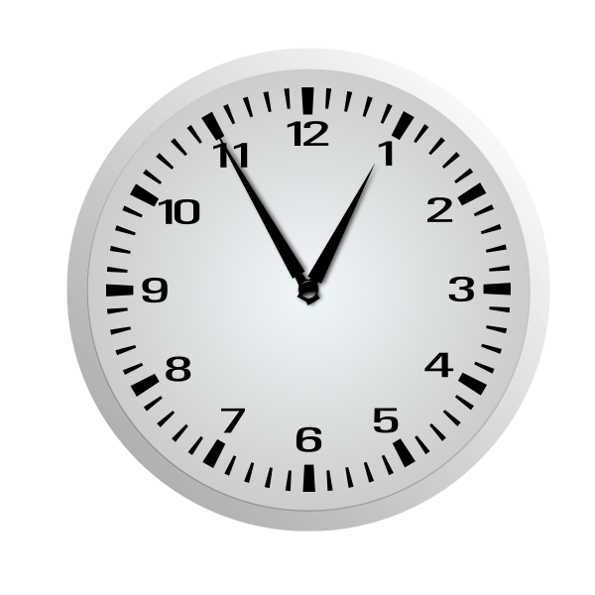
Step 1 - First Bell (5 minutes Left)
When the first bell rings, it means you have 5 mins to:
  Stop eating and clean up
  Put away your lunch and tidy your area
  Get ready to begin independent reading

Slide 6
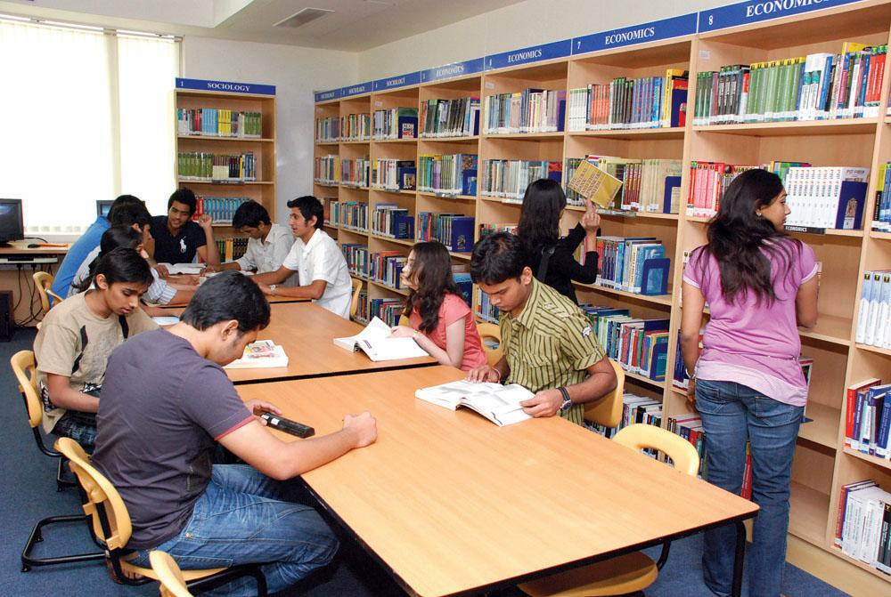
Step 2 - Move to your desk/move around room
After cleaning up, walk room quietly and calmly
Get your book out (from our book bin, desk or backpack)
Sit down at your desk and get ready for the second bell

Slide 7

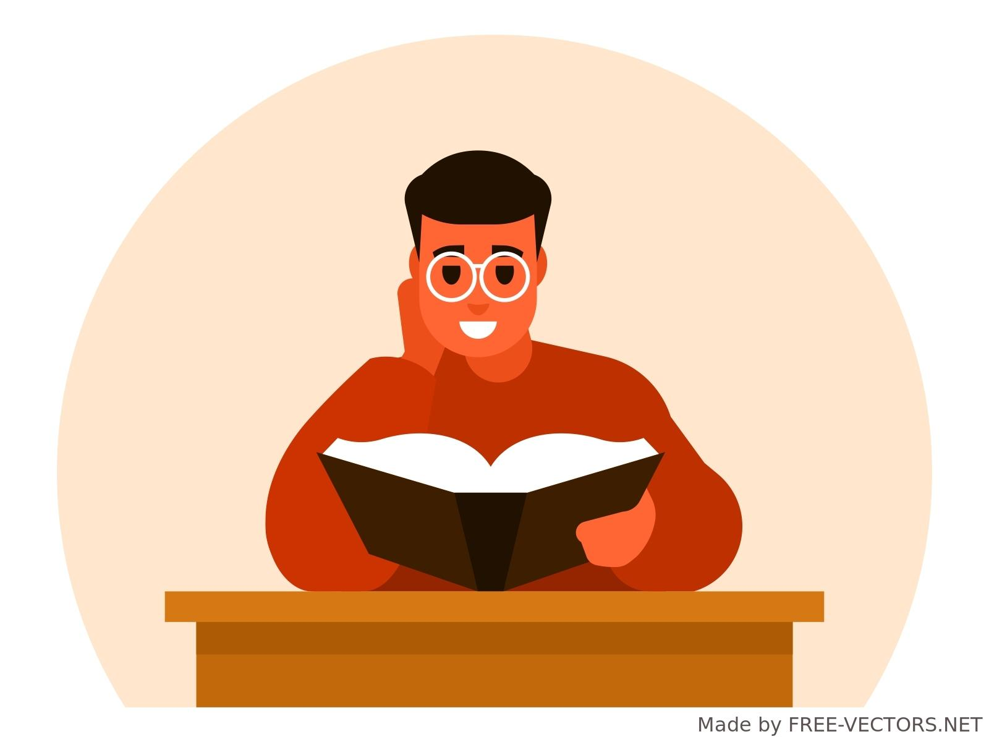
Step 3 - Second bell (Start Reading)
When the second bell rings, it's time to start reading!
  Your area should be clean and quiet
  You should have your book ready, and be seated at your desk
  Stay focused on your reading for the full time

Slide 8
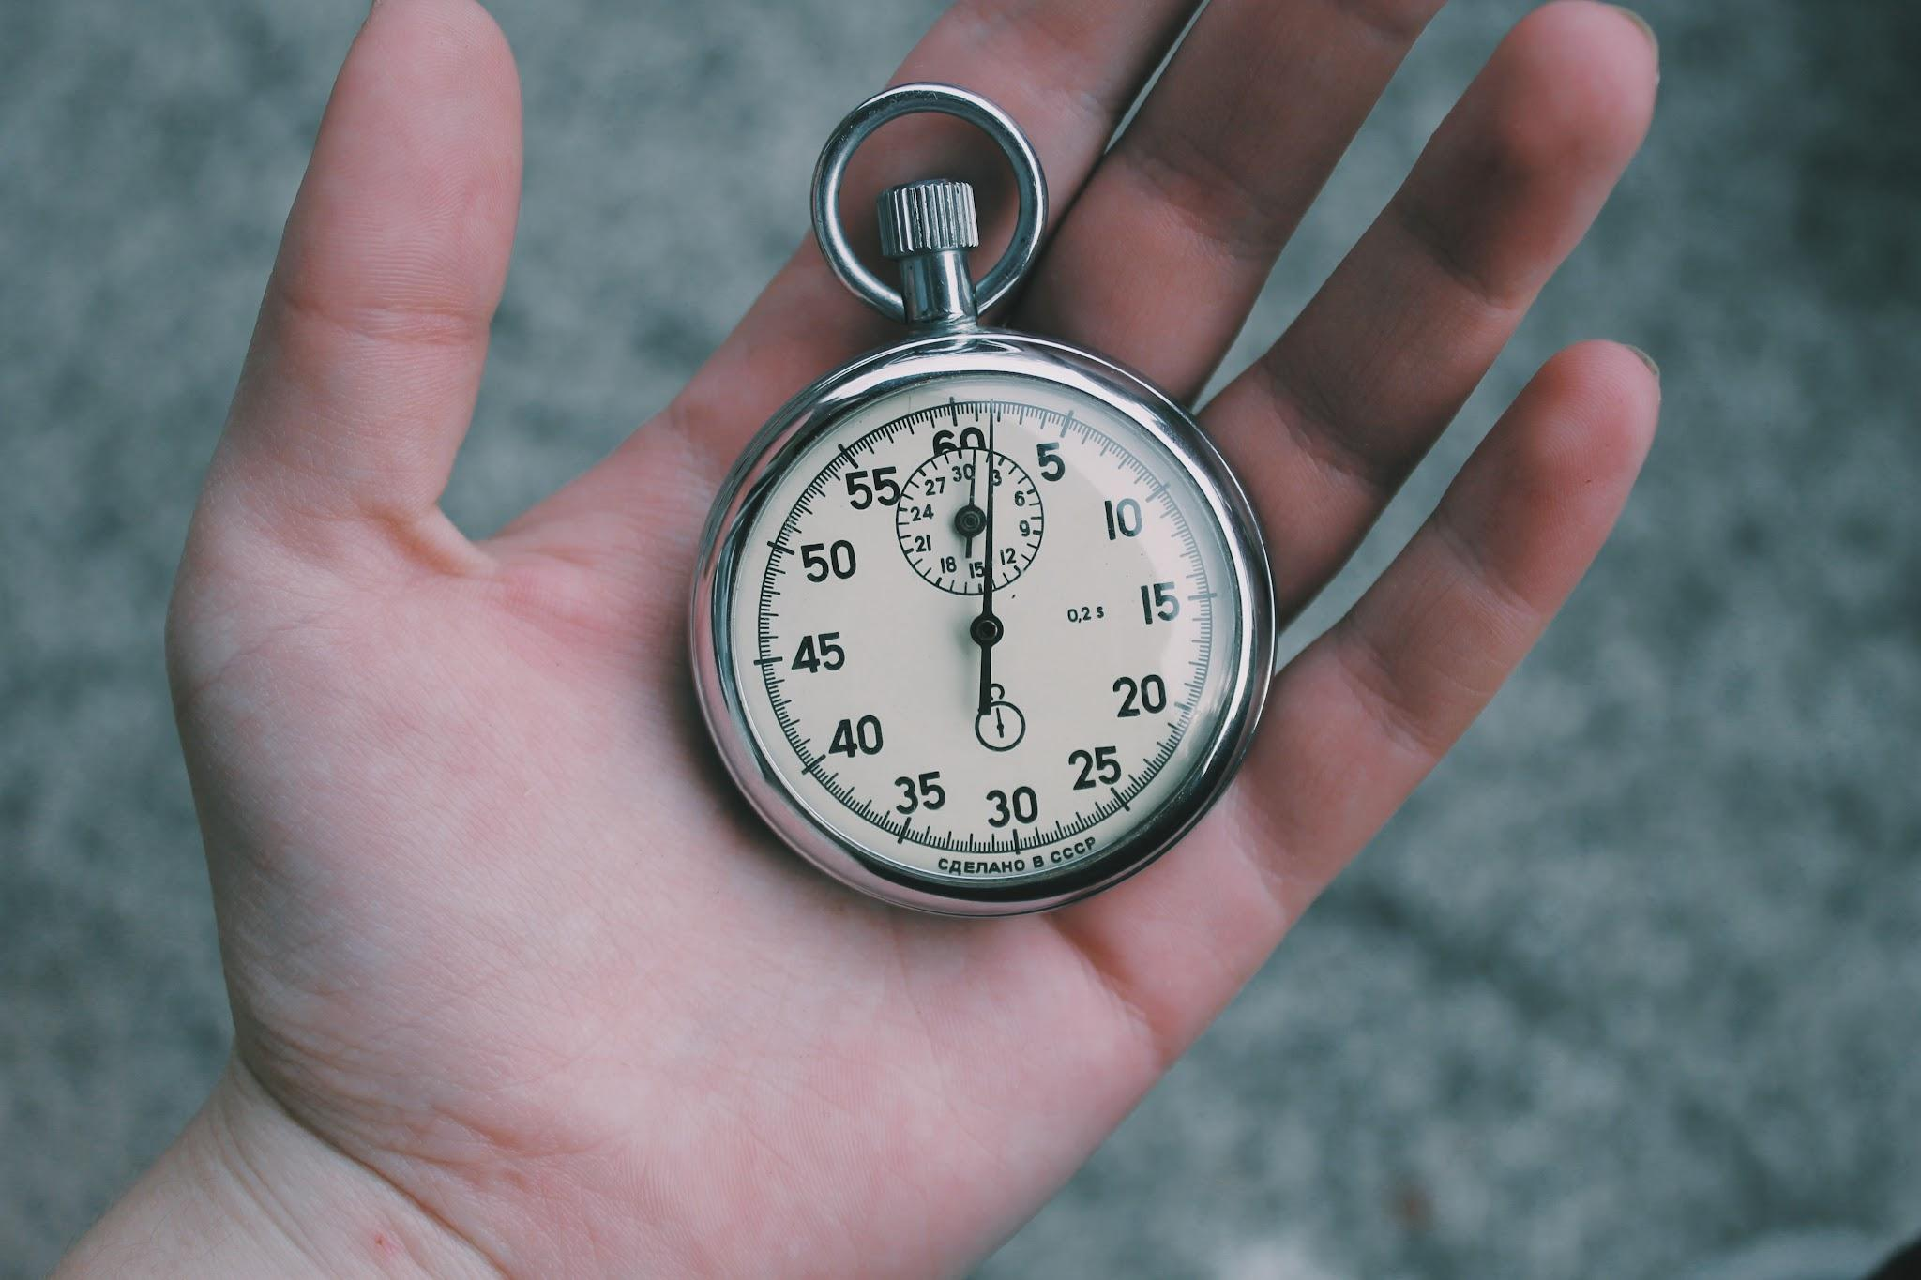
Step 4 - Reading Time (15-20 Minutes)
Once everyone is seated and ready, I’ll set a timer for 15-20 minutes
Use this time to read quietly and focus
If you finish your book early, get another book or quietly do a review reading activity

Slide 9
Expectation During Reading Time
This is quiet time
If you have a question, raise your hand silently
Stay in your seat and focus on your book
Non-Expectation During Reading Time
This is not the time to ask to go to the bathroom or get a drink
This is not a time to talk to your friend
This is not the time to move around the room

Slide 10
Let’s Practice
We will now practice the routine together
  Can someone show me the expected way?
  Can someone show me the unexpected way?
Listen for the bells and follow each step
Let’s see how smoothly we can transition to reading

Slide 11
Well Done
Great job practicing the routine!
Remember: this helps us get organized and enjoy our reading time.
What’s one thing you’ll work on to improve your transition after lunch?

Slide 12
Thank You

