Slide 1


Slide 2

MATERIALS NEEDED
Small trash can or Basket
Soft ball or crumpled up paper balls
Whiteboards and markers or sheets of paper
Multiplication and division problems (can be on google slides or index cards)
Scoreboard (Optional)
SET UP
Divide the class into teams (depending on class size)
Set up the shooting area - Place trash can or basket at a designates distance from shooting lines.
Have questions on slides or index cards

Slide 3
RULES
Teams will receive a problem and use their whiteboards to solve it.
Teams will have 1-2 minutes to collaborate and write their answer on the whiteboard.
Teams will flip their boards. Those with the correct answer will then choose a team member to take a shot for points.
Scoring
There will be 3 different point lines to choose from
Free Throw = 1 point, Paint Point = 2 Points and 3 Point line = 3 Points

Slide 4
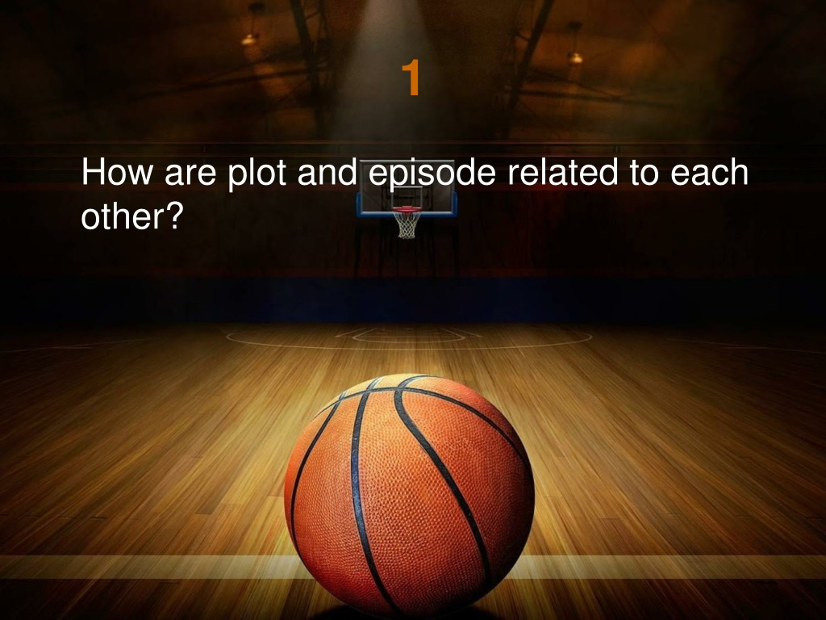
GRADE 4 MATHEMATICS
Development of computational fluency and multiplicative thinking requires analysis of patterns and relations in multiplication and division.

Slide 5

QUESTIONS TO UNDERSTAND MULTIPLICATION
1. Count equal groups
Question
Fill in the blanks to describe the model.
There are _____ groups of dots.
There are _____ dots in each group.

Slide 6

Solution
Count the number of groups.
There are 3 groups of dots.
Each group has an equal number of dots. Count the number of dots in a group.
There are 4 dots in each group.
1 2 3
1
4
2
3

Slide 7
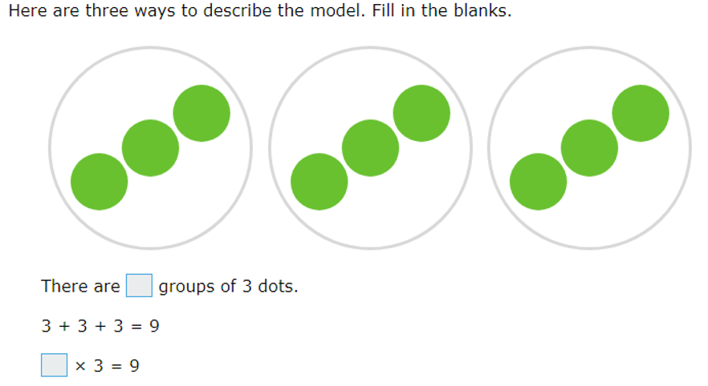
2. Relate addition and multiplication for equal groups

Slide 8
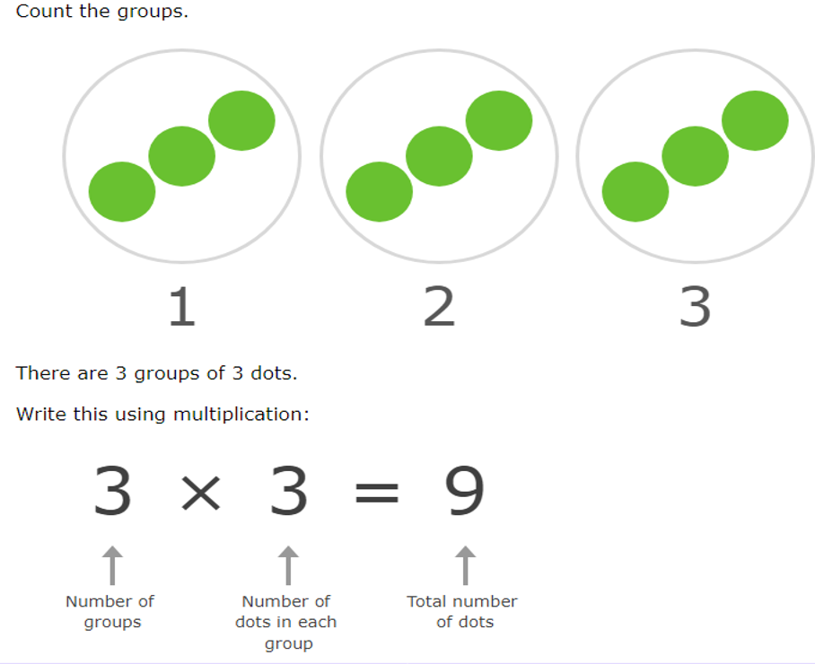
Solution

Slide 9
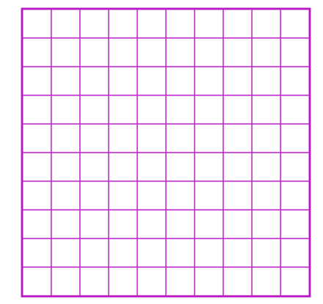
3. Make arrays to model multiplication
Question
Make a rectangular array of
squares to model 3 x 5 = 15

Slide 10
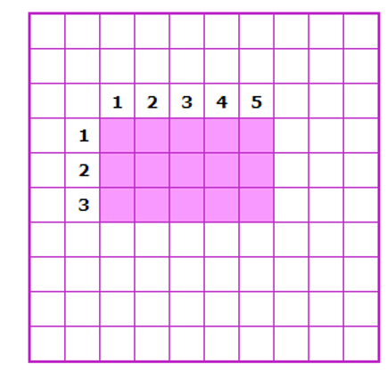
Solution
Arrays are made up of rows.
All the rows have the same length.
An array that models 3 × 5 = 15 has 3 rows with 5 squares in each row.
There are 15 squares in the array.

Slide 11
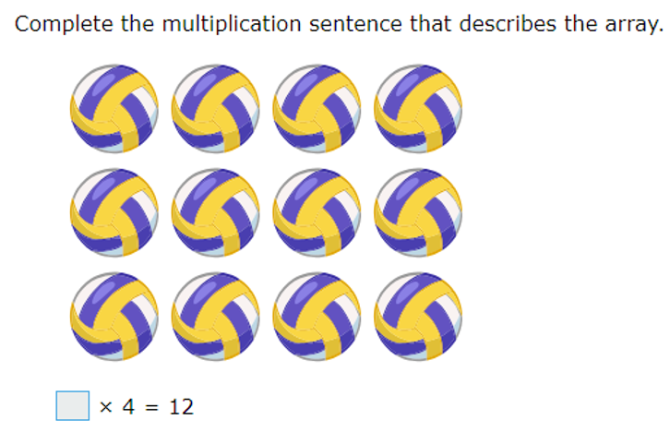
4. Write multiplication sentences for arrays

Slide 12
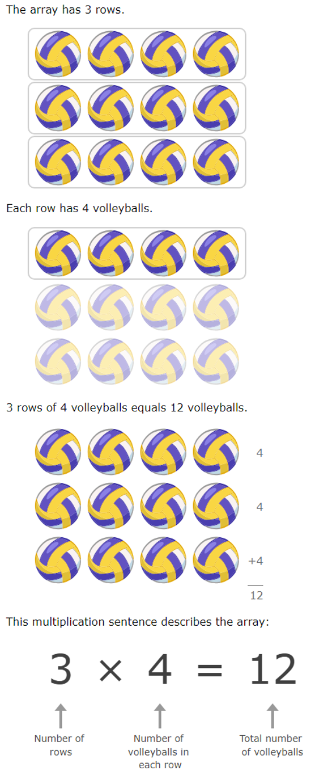
SOLUTION

Slide 13
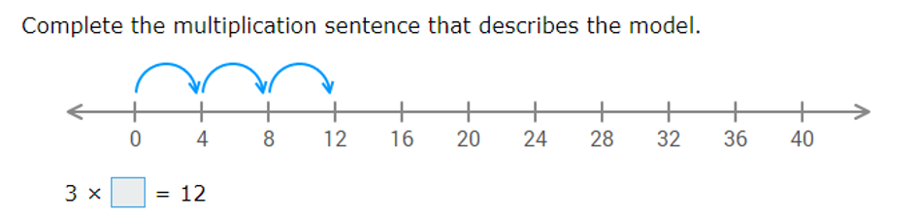
5. Write multiplication sentence for number lines

Slide 14
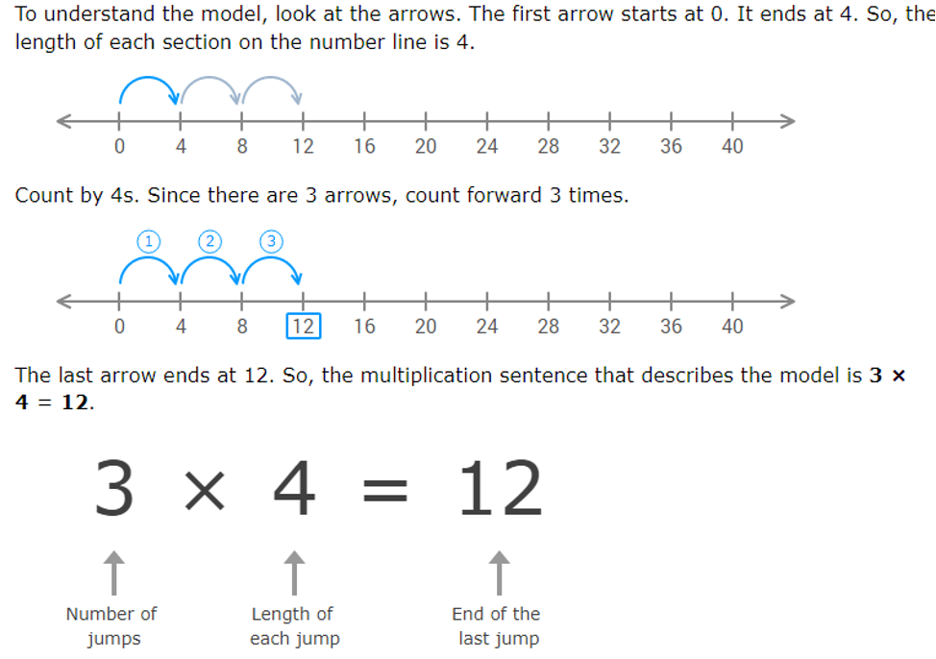
SOLUTION

Slide 15
Grade 4 Mathematics
Development of computational fluency and multiplicative thinking requires analysis of patterns and relations in multiplication and division.
Curricular competency
Understanding and solving
Develop, demonstrate and apply mathematical understanding through play, inquiry and problem solving
Communicating and representing
Communicating mathematical thinking in many ways
Represent mathematical ideas in concrete, pictorial and symbolic forms
Connecting and reflecting

