Slide 1
Visioning Project
By Terri Wilkinson
Bachelor of Education, University of Northern British Columbia
EDUC 393: Foundations of Education
Melanie Baerg
November 27, 2023

Slide 2
Land Acknowledgement
I recognize that I am presenting on the unceded traditional Ts’msyen (Tsimshian) territory of the Kitsumkalum and Kitselas First Nation

Slide 3
First Peoples Principles of Learning
  I will incorporate FPPL into my classroom by,
  Incorporating indigenous perspective, values and ways of learning
  Integrating indigenous perspective into my curriculum through stories, language and lessons
  Fostering learning built on respect, trust and collaboration
  Engaging in local community supports
  Incorporating hands on learning through activities, storytelling and art
  Incorporating ongoing self refection and professional development
  (FNEFC, 2023)

Slide 4
“We Teach Who We Are”
Single mother of 2
Personal trainer, group fitness instructor
Lover of sports and being active
EA
Survivor
ADHA
Compassion, empathy, kindness
Passion to teach, learn, grow
Ally in training
Learning is holistic, reflexive, reflective, experiential, and relational (focused on connectedness, on reciprocal relationships, and a sense of place)
Learning is embedded in memory, history, and story
Learning requires exploration of one’s identity

Slide 5
A Day In The Life Of My Ideal School
Daily Schedule
Healthy and Nutritious Food Programs
Daily Check in
DPA
Ideal Classroom
Literacy/Math through Differentiated Instruction
Nurturing and Supporting
Collaboration

Slide 6

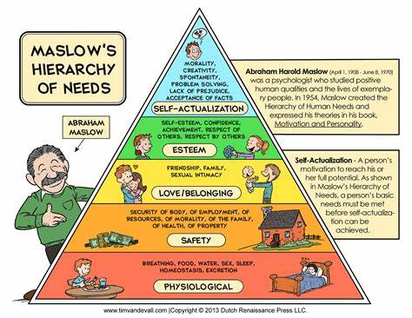
Healthy and Nutritious Food Programs
Breakfast Club of Canada
Breakfast programs ensure that all students have reliable access to nutritious food in a safe and supportive environment, in order to positively impact health and learning (Detonnancour, 2023)
Maslow’s hierarchy of needs says, we cannot expect children to learn if their basic needs are not met (Maslow, 1943)
Guiding Principles
Give access to a healthy breakfast in a warm, inviting setting every day.
Be available to all students at the elementary and high school level.
Have every breakfast served by welcoming and attentive adults.
Encourage students to volunteer their time to develop life skills, leadership acumen and self-confidence.
(Detonnancour, 2023)
Learning ultimately supports the well-being of the self, the family, the community, the land, the spirits, and the ancestors

Slide 7
Healthy and Nutritious Food Programs
BC School Fruit & Vegetable Nutritional Program
Lunch Program
- It increases students' acceptance of, exposure to, and willingness to try fruits and vegetables.
- It increases students' knowledge and awareness of fruits and vegetables as nutritious foods to eat.
- It increases knowledge and awareness of locally grown foods.
- It increases access to local fruits and vegetables in BC schools
It supports BC's economy and builds relationships between industry partners by working with local growers and distributors to bring fresh BC products to schools across the province
(bc agriculture)
Ensures access to nutritious lunch
Enhance students concentration and academic performance for afternoon learning
Promotes healthy eating habits
Creates a positive social environment
Fosters community and inclusivity
(leadership, serving, fine dinning)
(Care, 2023)
Learning ultimately supports the well-being of the self, the family, the community, the land, the spirits, and the ancestors

Slide 8
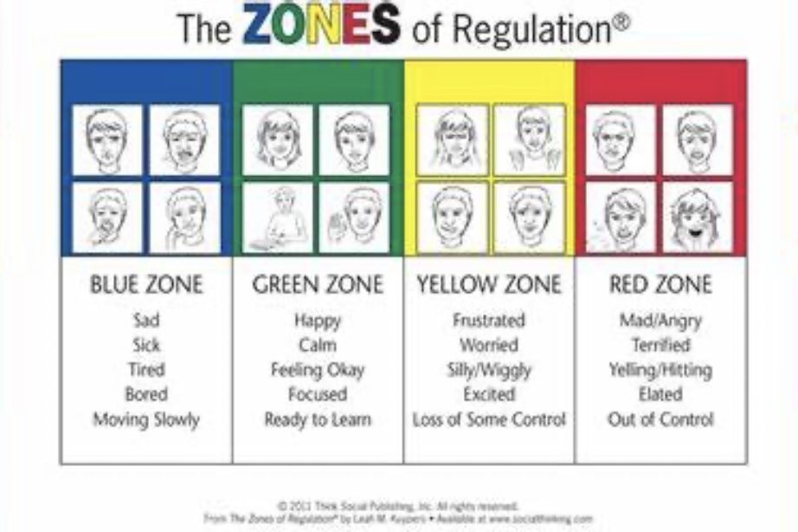
Daily Check in
Zones of Regulation
Zones of Regulation
The Zones of Regulation is an approach used to support the development of self regulation in children. All the different ways children feel and the states of alertness they experience are categorized into four coloured zones
The four zones consist of the green, yellow, blue and red zone.
The green zone represents feeling calm and happy
The yellow zone represents feeling silly, frustrated, or anxious
The blue zone can represent feeling tired or sad
The red zone represents feeling angry
Using the Zones of Regulation, we teach children how to identify their feelings, be aware of which zone they are in, and give them tools to help themselves regulate and move to the appropriate zone
(zones, 2023)
Learning involves recognizing the consequences of one’s actions

Slide 9

DPA – Daily Physical Activity
Physical activity helps children:
- develop cardiovascular fitness, strength, flexibility, and bone density
- maintain a healthy body weight
- reduce the risk of chronic disease and health problems
- lessen the likelihood of tobacco, alcohol, and drug use
- feel better every day, through improved mental health and well-being
(Canada, 2016)
Learning requires exploration of one’s identity
Learning ultimately supports the well-being of the self, the family, the community, the land, the spirits, and the ancestors

Slide 10
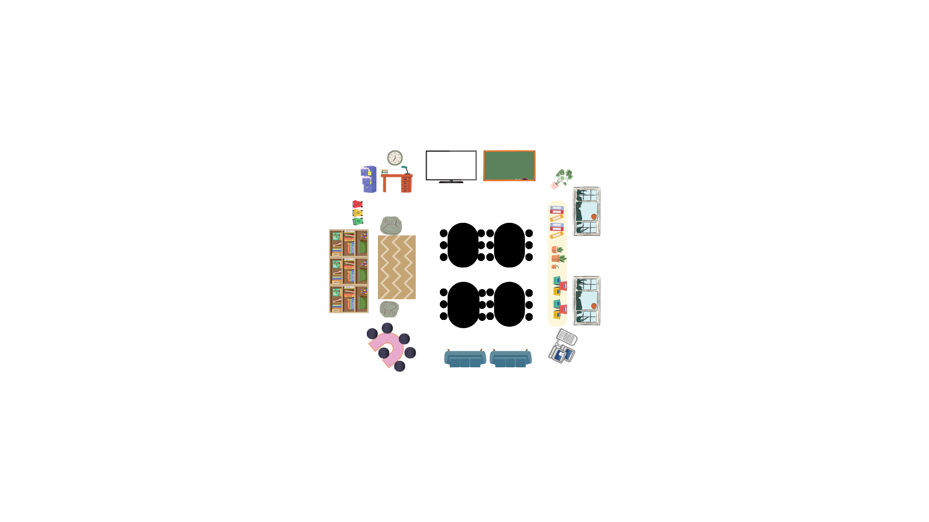
Learning involves generational roles and responsibilities
Learning recognizes the role of indigenous knowledge
My Ideal Classroom
Dynamic space
Fosters creativity
Collaboration
Critical thinking
Safe space
Inclusion
Diverse resources
Tech integration
Flexible seating
Encourages curiosity and active participation

Slide 11
Literacy and Mathematics through Differentiated Instruction
Want students to feel confident with numeracy and literacy skills
Will use daily 5, Heggerty, secret stories, and UFLI programs for literacy
Will use daily 3 and Carol Fullerton programs for numeracy
Will use benchmarks and assessments to inform instruction and practice
Will use many forms of teaching including, technology, games, resources
Will incorporate play based learning
Will have small group work, students separated into skill level to meet students where they are at but push them to where they need to be
Learning involves patience and time

Slide 12
Nurturing and Supporting Programs and Spaces
Before school activities
Breakfast club, snacks and lunch program
Choice activities for lunch time, reading, sports, art, Lego lab etc.
Afterschool programs including sports, art, technology, cooking etc.
Library open door policy, morning, noon and afterschool
Academies groups
Strong start program
Zen Zone
First Nation Support works support
Student designed rooms, “our room” learning lab, “the green room” Lego lab
Student voice, choice and input
Trauma in formed lens for staff
Growth mindset
Star fish food bag program
Laundry room and “closet”
Learning ultimately supports the well-being of the self, the family, the community, the land, the spirits, and the ancestors
Learning requires exploration of one’s identity
Learning involves recognizing that some knowledge is sacred and only shared with permission and/or in certain situations

Slide 13
Collaboration – “Surviving not Thriving”
Thank You!!!
Allows for sharing of ideas, resources and best practices
Fosters a supportive environment
We learn from each other
Enhances professional development
Promotes innovative teaching methods
Benefits the students by providing more diverse learning experiences
Learning ultimately supports the well-being of the self, the family, the community, the land, the spirits, and the ancestors
Learning is holistic, reflexive, reflective, experiential, and relational (focused on connectedness, on reciprocal relationships, and a sense of place)
Learning involves generational roles and responsibilities
Learning involves patience and time

Slide 14
References
Detonnancour, G. (2023, November 13). Grow healthy students. Breakfast Club of Canada. https://www.breakfastclubcanada.org/
Maslow, A.H. (1943). “A Theory of Human Motivation”. In Psychological Review, 50(4), 430-437. Washington, DC: American Psychological Association.
Homepage. BC Agriculture in the Classroom Foundation. (n.d.). https://www.bcaitc.ca/
Care, E. and C. (2023, April 4). School Food Programs get historic investment to help Feed Kids. School food programs get historic investment to help feed kids. https://news.gov.bc.ca/releases/2023ECC0020-000424
Zones of regulation. The Zones of Regulation. (2023, July 28). https://zonesofregulation.com/
Canada, P. H. A. of. (2016, January 22). Government of Canada. Canada.ca. https://www.canada.ca/en/public-health/services/being-active/children-physical-activity.html
Quality first nations education in BC. First Nations Education Steering Committee FNESC. (n.d.). https://www.fnesc.ca/

